Slide 1
Sprint 02
TadoSoft
Team JJJ
29, Jun, 2011

Slide 2
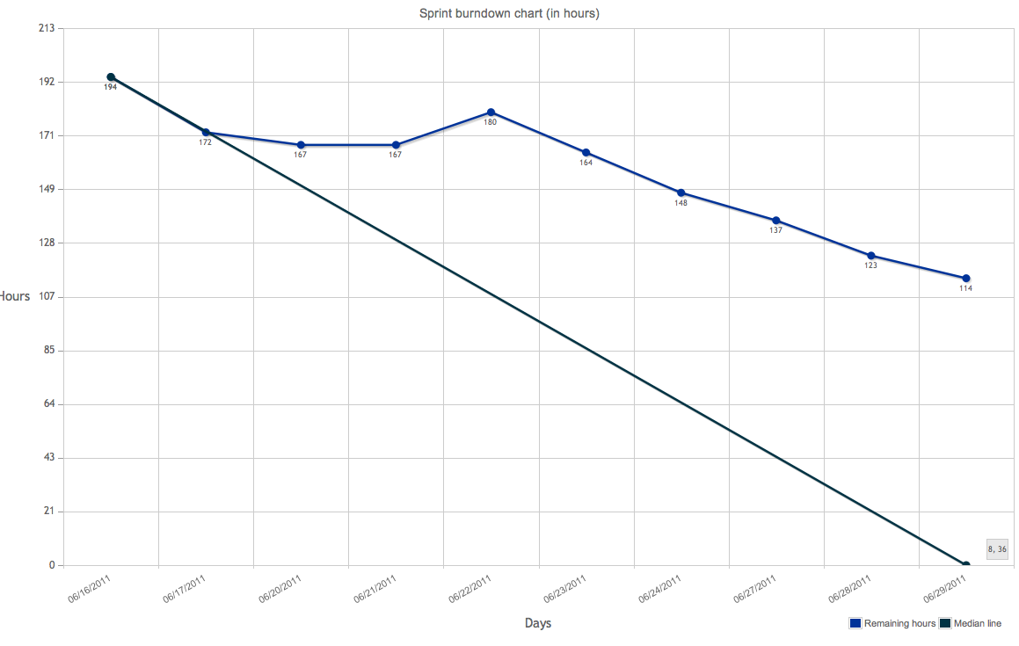
Burndown chart

Slide 3
DoD
Code
code style: Follow Xcode/Eclipse default style
complexity: <= 15 for each function (with hfcca or cyvis tool)
duplexity: <= 50 for each function (with CPD tool)
no fault
no warning
use DLog() instead of NSLog() in Obj-C
frozen version for every sprint with a GIT tag
Test
no leaks for Obj-C with XCode Instrument
Capacity&Performance test for server
unit test
Manually functional test
Document
class doc generated by Doxygen for every class, function, variable, constant with Javadoc style
design doc in word format, stored in GIT
Functional test cases(Precondition, Expect result, steps, Actual result, tester, date)

Slide 4
Committed Items
150 Facebook Login
168 Server Intigration
125 Join a Krowd
160 Krowd Sorting
138 Krowdit Created Krowd
169 Krowdit Krowds
149 Password Recovery
172 Jak Search
173 JaK Krowd Expantion
134 Jak Logout

Slide 5
Code Duplexity
The CPD tool doesn’t support obj-c language. There is a 3rd-party lib, but it doesn’t work
For java language, only one warning about the same comments of Signup servlet and Login servlet, because of the same template, that can be ignored.

Slide 6
Code Complexity (objC on iPhone)
Warnings (CCN > 15) !!!!
97 18 351 parse@148@./json-framework/Classes/SBJsonStreamParser.m
97 18 351 parse@148@./untitled folder/Krowdit/Krowdit/JSON/SBJsonStreamParser.m
86 18 270 parse@170@./untitled folder/krowdit-ios/Krowdit/SBJson/SBJsonStreamParser.m

Slide 7
Code Complexity (java on server)
No class >=15

Slide 8
Document
http://192.168.1.113/mediawiki/index.php/AcceptanceTestCase

Slide 9
Issues
http://192.168.1.113/mantis/view_all_bug_page.php

Slide 10
Q&A

Slide 11
Retrospective
Make requirement clear ASAP.
Design ATC in the beginning of sprint
Use text and diagram to help design
Personal knowledge management
Take note how the root cause of problem
Useful links is recorded on Wiki
Search more with google or App Doc Center
Debugger, memory management
AP to Jacky: training
Design Test case
AP to Ryan: training
Report bug on Mantis
AP to Fujing: report bugs for this sprint

Slide 12
Retrospective

